Slide 1
Latentview Introduction & Capabilities
Sep, 2018

Slide 2
Agenda
1
An Introduction to LatentView
2
LatentView Engagement with BMW
3
SmartInsights – Driver Profiling & Risk Identification
4
Customer Success Stories from Other Industries

Slide 3
Introduction to LatentView

Slide 4


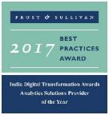




LatentView Analytics at a glance
Awards & Recognition
Founded in
Over
Grown
Work with
Strong Performer - Customer Analytics Services, 2017
550
11
30+
2006
People strong
times in last
six years
Fortune 500
firms
Member of
Only company recognized
2009-2017
Technology council
Frost & Sullivan
Analytics Solutions Provider 2017
Repeat
Business at
4/5
9
top technology companies work with us
>85%
#1
consecutive times in Deloitte Technology Fast50
Analytics Company of the Year 2015
Notes:
LatentView is a leading global analytics and decision sciences provider, delivering solutions that help companies drive digital transformation and use data to gain a competitive advantage.
With analytics solutions that provide 360-degree view of the digital consumer, fuel machine learning capabilities and support artificial intelligence initiatives., LatentView enables leading global brands to predict new revenue streams, anticipate product trends and popularity, improve customer retention rates, optimize investment decisions and turn unstructured data into a valuable business asset.
LatentView is a trusted partner to enterprises worldwide, including more than two dozen Fortune 500 companies in the retail, CPG, financial, technology and healthcare sectors. LatentView has more than 550 employees in offices in Princeton, N.J., San Jose, Calif., London, Singapore and Chennai, India.
Awards and recognition:
India Emerging 20 (IE20) Award (2016)
Frost & Sullivan Analytics Company of the Year (2015 & 2017)
Deloitte Fast50 (Eight consecutive years, 2009-2016)
Advanced Consulting Partner to Amazon Web Services
Micrsoft Gold Partner in advanced analytics
Gartner Cool Vendor: Advanced Analytics Service Providers for Marketing
Founder Venkat Viswanathan inducted into the Forbes Customer Council

Slide 5


Trusted analytics partner to the world’s most recognized brands
The LatentView Approach
We empower customers in their transformation journey by helping them move up the analytics maturity curve through actionable insights that leads to data-driven decisions that achieve business goals.

Slide 6
Enabling the data driven decision making journey by…
…getting the data together
…making sense of the data
...applying AI & ML to drive impact
Data Acquisition
Acquiring & consolidating the disparate data sources.
Data Engineering
Integrating various forms of data into centralized data lake using on-premise & cloud based technologies
Data Processing
Process various forms of disparate data – Structured, Unstructured, Physical, Human Interactions, Machine Generated, Real Time etc
Graph Analysis
Exploration of frequency, strength and direction of relationships & Causalities.
Exploratory Analysis
Deep insights from all forms of data using traditional methods (Segmentation & Clustering)
Natural Language Processing
Analyze dimensional insights & relationships by automated tagging
Real Time Analytics
Experience in sub-second big data processing for real time applications
Deep Learning & AI
Self governing systems leveraging AI & eliminating manual intervention
Machine Learning
Deep experience with various machine learning algorithms, including Ensemble Learning, Neural Networks, etc.

Slide 7










1. Getting the data together
How to acquire data?
How to create a unified data view?
How to enable consumption?
Structured Data
External / Internal
Customer Data
Web Data
Data Integration
METRIC & EXCEPTION
REPORTS
Marketing Data
Structured
Payment Data
Data store pipelines enables metric & exception reporting
App Data
INTERACTIVE VISUALIZATON
Data Lake
Dispute Information
API endpoints enabling integration with
other systems
OPERATIONAL
Unstructured Data
External / Internal
Voice Data
Unstructured
ML / AI Workbench for
Prediction & Insights
Chat Data
ADVANCED
ANALYTICS
Email Data
Biometric Data
Social Data
Other data sources

Slide 8
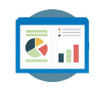




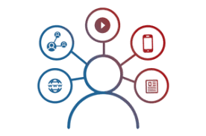


2. Making sense of the data
Reporting & Visualization
Performance Management, KPI Measurements
Monitoring & Control
Real Time Assurance, Audit & Compliance
Voice of Customer
Criticalities, Competitive Intelligence
Segmentation & Clustering
Personalization, Appropriateness etc.
Relationship & Causalities
Implementation, Strategy &
Prioritization
Digital Analytics
Consumer Journeys, Marketing Effectiveness
Experimentation
Experimentation at scale, A/B testing etc.
Integrated & Disparate sources in Data Lake

Slide 9



3. AI / ML to drive business impact
Business Planning
Demand Prediction
Market Strategy
Strategic Investments
Early Warning Alerts
Customer Complaints
Transactional Risks
Loss Prevention
Innovation / Insights
Voice of Consumer
Competitive Intelligence
Product Governance
Customer Engagement
Personalization
Acquisition & Conversion
Customer Experiences
Self Serve Analytics through Micro Applications
Complex Data Linearly Scalable With Data Volume
Faster Time To Market Due To Less Set Up Time
Artificial Intelligence / Machine Learning
Integrated & Disparate sources in Data Lake

Slide 10
Projects within BMW

Slide 11
Projects within BMW
Department | Area of Work | Goal | Topic / Theme / Usecase
AQ-16 | Preventive Maintanance & Cost Reduction | Leveraging data to identify driving profile & optimize warranty costs | Phase 1: Analyse driving profiles Phase 2: Determing Risk, Costs of breakdown & recommend service action (Customer Care Package)
AQ - S / AQ-14 | Customer Satisfaction scoring & Dealer Inteligence & Customer 360⁰ | Good Will Management: Leverage data to improve dealer interactios with custome | Provide 360° customer view to dealers about customer i.e. Past sales, Service experience & Special care needed Considered data: Connected Vehicle, Service KPI, CRM
AU-8 / TV-11 / TV-14 | Order to Delivery Demand Management | Optimize production & sales costs by identifying demand shifts in vehicle configuration / customization | Using Social Media & publicly available data to study various unforeseen demand shifts - Ex: Diesel Engines after VW Diesel gate scandal.
AK-24 | Brand Reach & Audience Perception | 1. Determine the role of BMW Motorsports to BMW brand 2. Derive insight for Motorsport vehicle development | Use of Social Media & Publicly available data to analyze Audience perception, engagement & insights BMW`s reach in relation to competitors Effectiveness of Motorsports communication
Notes:
LatentView is a leading global analytics and decision sciences provider, delivering solutions that help companies drive digital transformation and use data to gain a competitive advantage.
With analytics solutions that provide 360-degree view of the digital consumer, fuel machine learning capabilities and support artificial intelligence initiatives., LatentView enables leading global brands to predict new revenue streams, anticipate product trends and popularity, improve customer retention rates, optimize investment decisions and turn unstructured data into a valuable business asset.
LatentView is a trusted partner to enterprises worldwide, including more than two dozen Fortune 500 companies in the retail, CPG, financial, technology and healthcare sectors. LatentView has more than 550 employees in offices in Princeton, N.J., San Jose, Calif., London, Singapore and Chennai, India.
Awards and recognition:
India Emerging 20 (IE20) Award (2016)
Frost & Sullivan Analytics Company of the Year (2015 & 2017)
Deloitte Fast50 (Eight consecutive years, 2009-2016)
Advanced Consulting Partner to Amazon Web Services
Micrsoft Gold Partner in advanced analytics
Gartner Cool Vendor: Advanced Analytics Service Providers for Marketing
Founder Venkat Viswanathan inducted into the Forbes Customer Council

Slide 12
Projects within BMW
Department | Area of Work | Goal | Topic / Theme / Usecase
AQ-16 | Customer Feedback Analysis | Fully automated & highly accurate classification of Voice of customer data using Machine Learning | Data Sourcing, Lexical Processing of unstructuded data & Machine learning for classfier for new sets of data
AQ-14 | Building Customer Experience Score | The scoring model will generate a score for every customer using internal and external data sources like vehicle data, services data, survey responses & customer feedback | Internal & external data (NPS) is combined to build models to predict the customer experience. Multiple machine learning models have been build to finalize the scoring methodology
Notes:
LatentView is a leading global analytics and decision sciences provider, delivering solutions that help companies drive digital transformation and use data to gain a competitive advantage.
With analytics solutions that provide 360-degree view of the digital consumer, fuel machine learning capabilities and support artificial intelligence initiatives., LatentView enables leading global brands to predict new revenue streams, anticipate product trends and popularity, improve customer retention rates, optimize investment decisions and turn unstructured data into a valuable business asset.
LatentView is a trusted partner to enterprises worldwide, including more than two dozen Fortune 500 companies in the retail, CPG, financial, technology and healthcare sectors. LatentView has more than 550 employees in offices in Princeton, N.J., San Jose, Calif., London, Singapore and Chennai, India.
Awards and recognition:
India Emerging 20 (IE20) Award (2016)
Frost & Sullivan Analytics Company of the Year (2015 & 2017)
Deloitte Fast50 (Eight consecutive years, 2009-2016)
Advanced Consulting Partner to Amazon Web Services
Micrsoft Gold Partner in advanced analytics
Gartner Cool Vendor: Advanced Analytics Service Providers for Marketing
Founder Venkat Viswanathan inducted into the Forbes Customer Council

Slide 13













Areas of Work
Projects within BMW
Advanced Analytics
ORDER TO DELIVER
CES
Machine Learning
SMART INSIGHT PLATFORM
CUSTOMER 360
AQ 14 DASHBOARDS
Data Visualization
Our Capabilities
Text Mining
MOTORSPORTS
Voice of Customer
Web Analytics
SMARTINSIGHTS
Data Engineering
Notes:
LatentView is a leading global analytics and decision sciences provider, delivering solutions that help companies drive digital transformation and use data to gain a competitive advantage.
With analytics solutions that provide 360-degree view of the digital consumer, fuel machine learning capabilities and support artificial intelligence initiatives., LatentView enables leading global brands to predict new revenue streams, anticipate product trends and popularity, improve customer retention rates, optimize investment decisions and turn unstructured data into a valuable business asset.
LatentView is a trusted partner to enterprises worldwide, including more than two dozen Fortune 500 companies in the retail, CPG, financial, technology and healthcare sectors. LatentView has more than 550 employees in offices in Princeton, N.J., San Jose, Calif., London, Singapore and Chennai, India.
Awards and recognition:
India Emerging 20 (IE20) Award (2016)
Frost & Sullivan Analytics Company of the Year (2015 & 2017)
Deloitte Fast50 (Eight consecutive years, 2009-2016)
Advanced Consulting Partner to Amazon Web Services
Micrsoft Gold Partner in advanced analytics
Gartner Cool Vendor: Advanced Analytics Service Providers for Marketing
Founder Venkat Viswanathan inducted into the Forbes Customer Council

Slide 14
SmartInsights – Driver Profiling & Risk Identification

Slide 15
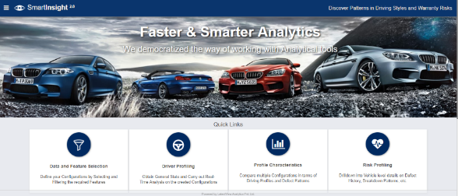
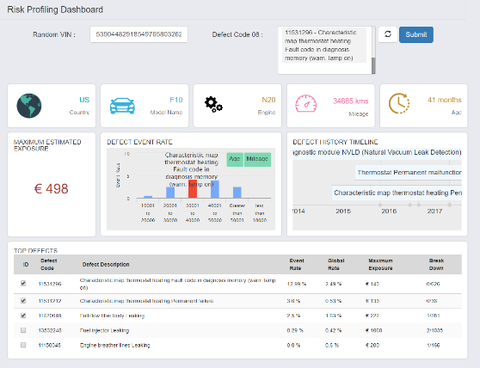
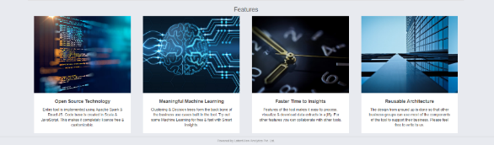
SmartInsights – Driver Profiling & Risk Identification
Notes:
LatentView is a leading global analytics and decision sciences provider, delivering solutions that help companies drive digital transformation and use data to gain a competitive advantage.
With analytics solutions that provide 360-degree view of the digital consumer, fuel machine learning capabilities and support artificial intelligence initiatives., LatentView enables leading global brands to predict new revenue streams, anticipate product trends and popularity, improve customer retention rates, optimize investment decisions and turn unstructured data into a valuable business asset.
LatentView is a trusted partner to enterprises worldwide, including more than two dozen Fortune 500 companies in the retail, CPG, financial, technology and healthcare sectors. LatentView has more than 550 employees in offices in Princeton, N.J., San Jose, Calif., London, Singapore and Chennai, India.
Awards and recognition:
India Emerging 20 (IE20) Award (2016)
Frost & Sullivan Analytics Company of the Year (2015 & 2017)
Deloitte Fast50 (Eight consecutive years, 2009-2016)
Advanced Consulting Partner to Amazon Web Services
Micrsoft Gold Partner in advanced analytics
Gartner Cool Vendor: Advanced Analytics Service Providers for Marketing
Founder Venkat Viswanathan inducted into the Forbes Customer Council

Slide 16


Project overview
Our solution
Driving Styles
1
Identify key driving styles using the vehicle controller data
What are the main driving styles?
Vehicle Usage from Connected Data
Warranty & Repair
Data
Warranty Claims
Driving Styles
Speed, Acceleration,
Longitudinal movement, Trip Length, Pause Duration, Temperature etc.
2
Compare driving styles with warranty claims data
Are there claim patterns to individual styles?
Repairs & Risk Patterns
Engine Mounts, Gasket Failure,
Oil Leakage.
Automated Hypothesis Testing
3
Use the tool to identify risk groups by dynamic profiling
Continuous Hypothesis Testing
Driver Segmentation, Risk Prediction & Maintenance at each Car (VIN) level

Slide 17




Project Goals & Work scope
Use Driving profile from connected vehicle data for the following use cases (strategic & tactical)..
„Which are the most likely warranty claims for a vehicle coming back after leasing?“
„Quality managers observes only a few warranty cases wants to know if he is facing a severe problem or not.“
Customer Care Package
Digital Reporting line
Risk prediction & Intelligence
On vehicle level
for extended care purposes
Identifying patterns on specific VINs and potential risky neighbours
„Product manager asks for the usages style of customers in different countries.“
„Quality engineers wants to know if there are common features of vehicles leading e.g. to breakdown“
Comparative Analysis
Warranty vs Features
Driving style & vehicle usage comparison across models and markets
Switch viewpoints between warranty issues to driving behaviors and vice versa.
and migrate the solution ”SmartInsight” into BMW infrastructure (Data Lake)..
Notes:
LatentView is a leading global analytics and decision sciences provider, delivering solutions that help companies drive digital transformation and use data to gain a competitive advantage.
With analytics solutions that provide 360-degree view of the digital consumer, fuel machine learning capabilities and support artificial intelligence initiatives., LatentView enables leading global brands to predict new revenue streams, anticipate product trends and popularity, improve customer retention rates, optimize investment decisions and turn unstructured data into a valuable business asset.
LatentView is a trusted partner to enterprises worldwide, including more than two dozen Fortune 500 companies in the retail, CPG, financial, technology and healthcare sectors. LatentView has more than 550 employees in offices in Princeton, N.J., San Jose, Calif., London, Singapore and Chennai, India.
Awards and recognition:
India Emerging 20 (IE20) Award (2016)
Frost & Sullivan Analytics Company of the Year (2015 & 2017)
Deloitte Fast50 (Eight consecutive years, 2009-2016)
Advanced Consulting Partner to Amazon Web Services
Micrsoft Gold Partner in advanced analytics
Gartner Cool Vendor: Advanced Analytics Service Providers for Marketing
Founder Venkat Viswanathan inducted into the Forbes Customer Council

Slide 18




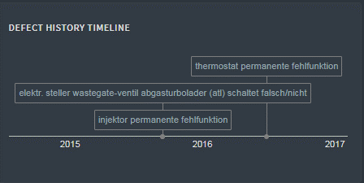

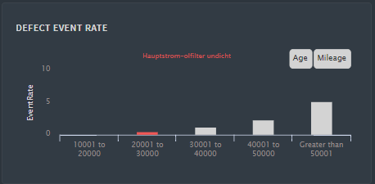
Extended Care Use case: Output
VIN
Estimated Maximum Exposure:
€ 3185,00
**86587869841
US
F10
28.752 KM
01.Sep.2015
Occurred Defects | Defect | Event Rate | Maximum Exposure | Break Down
 | Kennfeld-thermostat heizung fehler in diagn.speicher (warnlampe leuchtet) | 42.13% | € 1134 | N
 | Thermostat permanente fehlfunktion | 35.43% | € 989 | N
 | Kennfeld-thermostat heizung permanent ausgefallen | 8.31% | € 1062 | N
 | Diagnosemodul for tankleck nvld (natural vakuum leak detektion) permanent ausgefallen | 5.9% | € 1029 | N
 | Injektor undicht | 2.01% | € 3490 | N
 | Fahrleistung zu niedrig / tief / gering | 0.95% | € 947 | N
 | Konstantfahrt in allen betriebszustonden aussetzer | 0.48% | € 617 | N
 | Oelfilterdeckel innen undicht | 0.22% | € 4070 | N
 | Motor-entloftungsleitungen undicht | 0.0% | € 3079 | N
*
*
*
Dashboard

Slide 19
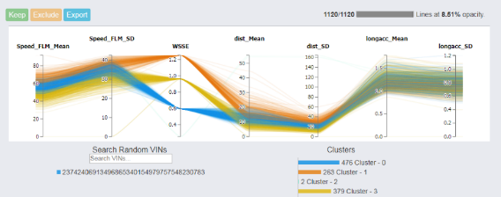
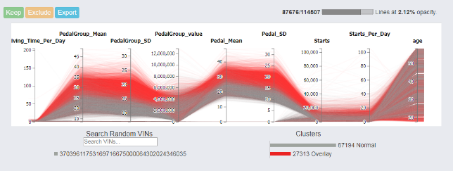
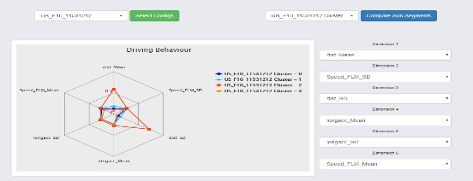
Extended Care Use case: Output

Slide 20

Key highlights of the application
End-to-End ML Solution
Smart Application
Modern analytics Architecture
Strong Business Focus
On-demand machine learning for driver profiling & predicting risky neighbours
Self-Service Data Preparation & Analytics
Enables Hypothesis testing/Use case Discovery
Reusable micro-services that can be integrated with other applications
Use of only Open Source Technologies- Spark, MongoDB , ReactJS & Scala
250 GB Spark Cluster
Data- Intensive application
Interactive User – Interface
Faster Time-to-Market
Currently built on 4.5 Million Readouts (11GB) & 2.8 Million Warranty Claims
Auto-Updated with latest data
Simplified User Interface masking the complexity of the application
Fast Loading time despite data-heavy views
Ability to visualize 700k VINs
Development & Testing time of 4 months
No of feature items : 187
No of test cases : 50
No of defects closed : 194
Notes:
LatentView is a leading global analytics and decision sciences provider, delivering solutions that help companies drive digital transformation and use data to gain a competitive advantage.
With analytics solutions that provide 360-degree view of the digital consumer, fuel machine learning capabilities and support artificial intelligence initiatives., LatentView enables leading global brands to predict new revenue streams, anticipate product trends and popularity, improve customer retention rates, optimize investment decisions and turn unstructured data into a valuable business asset.
LatentView is a trusted partner to enterprises worldwide, including more than two dozen Fortune 500 companies in the retail, CPG, financial, technology and healthcare sectors. LatentView has more than 550 employees in offices in Princeton, N.J., San Jose, Calif., London, Singapore and Chennai, India.
Awards and recognition:
India Emerging 20 (IE20) Award (2016)
Frost & Sullivan Analytics Company of the Year (2015 & 2017)
Deloitte Fast50 (Eight consecutive years, 2009-2016)
Advanced Consulting Partner to Amazon Web Services
Micrsoft Gold Partner in advanced analytics
Gartner Cool Vendor: Advanced Analytics Service Providers for Marketing
Founder Venkat Viswanathan inducted into the Forbes Customer Council

Slide 21
Leverage analytics for Customer centric business

Slide 22
Customer 360 & Voice of Customer

Slide 23
















Voice of Customer
Objective : The objective of the project is to automate the analysis of relevant customer feedback, which can be collected online from social networks, forums and other freely accessible platforms
Development of a web scraping pipeline to collect customer feedback verbatim
Structuring and storing information necessary for further usage and analysis
Classification of Preprocessed data into pre-defined classes of product parts and functions
DATA PREPARATION/AGGREGATION
SCORING and Validation
Data Sources
Data Cleaning
Topic Modelling to uncover the Key Topics at multiple layers of granularity
Stop words Removal
Removing Duplicates
Web Browser
Spam Removal
Insight Generation
Text Classification Using RNN
Data Transformation
Isolate Relevant
Content
Phrase Modeling
Sentiment Analysis
Using NN
Parts of Speech Analysis
Real time Analysis

Slide 24










Customer Experience Scoring
Objective : To build a scoring model for Customer Experience (CES). The scoring model will generate a relative score for every customer using internal and external data sources for a Top automotive industry client
Data Understanding & Data aggregation of customer data from various touchpoints.
Identifying & implementing model-based approaches to score a customer's experience.
Deliver the model output in a format that can be consumed by Business.
DATA PREPARATION/AGGREGATION
SCORING and Validation
Data Sources
Data Cleaning
Relative scoring of Customers based on the Rank
Service and Repairs Data
Removing Duplicates
Mapping Constraints
Web Browser
Dealer Interactions
Outlier Treatment
CES related Insight Generation
Incorrect/ Missing Values
Model based on Random Forest Regressor to Predict the scores
DATA MART
Customer Demographics
Data Harmonization
Vehicle Health Indicators
Real time Analysis
Data
Aggregation
Data
Transformation
Breakdowns
Validation of the Scores
Customer Feedback
Data
Merging

Slide 25
Product Recommendations

Slide 26


Integrating large volume of data from multiple sources
How to acquire data?
How to create a unified data view?
How to enable consumption?
Data Integration
CANNED REPORTS
Owned Data Sources
Structured
Relational Data Store
(Ex: AWS Redshift)
Enterprise Reporting Platform
SELF SERVICE BI
Data Lake
(Example: S3)
API endpoints
Indexing and Querying
(Ex: Elastic Search)
OPERATIONAL
External/Public Data Sources
Unstructured
Machine Learning Workbench
ADVANCED ANALYTICS
Distributed Processing
Feature Engineering
Data Sampling
(Ex: Spark)
Syndicated Data Sources
Real time Indexing
(Ex: Elastic Cache)
REAL TIME REPORTING
Data Type specific ETL toolset
Isolating Compute from Storage
Workload Aware Compute

Slide 27





Scaling up the machine learning solution to Big data
Built a product recommendation system for a leading food distribution company
and later scaled it up to include all 72 op-cos and all geographies leading to ~20% increase in the new orders by existing customers
Phase 2
Big data platform providing Machine learning solutions for 72 op-cos
Phase 1
Enabled Distributed processing and data pipelines for data across geographies
On Premise machine learning solution for 7 op-cos
Custom built cloud based tool delivering insights like:
Recommendation system for cross-sell opportunities (customers & deals)
Next best product recommendation
Data dimensions
Customer Segmentation
Customer
Order Anomaly Detection
Transaction
User Based Collaborative Filtering
Product Substitution
Geography
Market Basket Analysis
Revenue Management Use Cases
Products
Price
Final Recommendations
Real time recommendations
40K customers data
36X faster than linear approach
Serves 72 op-cos across USA

Slide 28
Connected Innovation

Slide 29




Connected Innovation
Product
Services
Connected
Innovation
Influence consumer behavior & engagement
Community
Predict consumer behavior
Enhance consumer experience & interaction
Platform
Understand the consumer better
Content
DESCRIPTIVE ANALYTICS – DEEPER INSIGHTS
PREDICTIVE ANALYTICS
PRESCRIPTIVE ANALYTICS

Slide 30
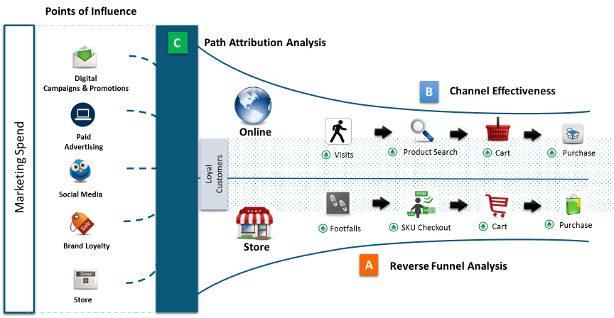
Consumer Goods – Digital Marketing
| Points of Influence | Path to Purchase | Customer Experience | Channel Effectiveness | Market Mix | Digital Metrics |

Slide 31



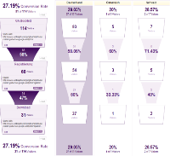






Path to Purchase
Client business operates through a combination of channels, owned stores, franchised stores and online.
Objective : Study online consumer behavior in order to optimize consumer experience and increase revenue and earnings.
Understand different purchase journey paths in an Omni-channel context
Identify points of influence for different purchase journeys
Understand the roles of Social, Digital, Email marketing, etc.
Methodology
Path to purchase visualization landscape
Reverse Funnel Analysis
Dominant Path Identification
Role of points of influence
Data Preparation
Sequence of pages leading to a Transaction
Drop off points
Statistical techniques: Markov chains , Levenshtein distance measure
Findings & Recommendations
Purchase Vs. drop-off behavior
High shipping costs lead to between 22-33% drop off in the Millennials after “adding to cart”

Slide 32
Thank you
Email: Vijay@LatentView.com
Phone: +44 787 9922 859

Slide 33




5. Digital Roadmap for Website-led Customer Acquisition
Leading Baby Food Nutrition Company
The Problem: Website enrollments/conversion rate of moms in key markets (US & Canada) was at a low 15% and was stagnant for two years
The “Before” State
LatentView Solution
The “After” State
Lack of a unified view on website activity resulting in little or no insights on improving customer engagement and personalization at the Zero Moment of Truth (ZMOT)
Built a comprehensive web analytics maturity framework covering enrollments, engagement and personalization and implemented it across markets
Website enrollment jumped to 19% on an average going up to 22% in certain markets like Canada and US with commensurate increase in website engagement levels
Tracking web enrolment journey
Website tagging
Website experimentation
Insights generation
Tracked enrollment funnel from the source till conversion and recommended solution at each step
Tagged the website to track the key metrics for all the website
Set up website experiments via Google Analytics and Optimize to do A/B testing
Recommended insights for each markets on a monthly basis to improve enrollment and engagement across markets

Slide 34

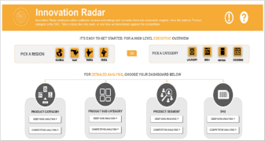








Data driven Product Innovation based on Consumer Reviews
Largest Home Appliances Manufacturer in US
The Problem: Lack of/Delayed access to direct customer feedback on their products and competitors’ can adversely affect a consumer durable company’s ability to innovate and keep customers happy
The “Before” State
LatentView Solution
The “After” State
Purchase drivers were determined by post-facto analysis of POS data at stores and survey data resulting in delays of up to eight months to get consumer feedback on product features
Built a real-time text analytics platform to consolidate external, unstructured data to ‘measure’ customer feedback of client’s brand with respect to competition on various parameters that drives purchase
Precise, fine-tuned innovation on product features and messaging was possible on an ongoing basis as consumer feedback reached the teams directly within 2.5 months of product launch
Industry Forums
Sentiment Analysis
Data Focus
Drivers of Purchase
Market Places
Int
Triggers of Purchase
Ext
Expert Opinion
Unstruct.
Struct.
Brand Websites
Consumer Rating
SAS VA Dashboards
Popular Features
Data Extraction & Data Landscape
Text Analytics
Notes:
Unilever – Trend Classification & Anomaly Detection

Slide 35





Precise Forecasting of Demand for Jewelry SKUs
World’s 3rd Largest Jewelry Manufacturer
The Problem: Accurate demand forecasts for new and existing SKU’s is essential in a vertically integrated supply chain for high value products
The “Before” State
LatentView Solution
The “After” State
Lack of consensus on demand forecast across different business functions and no centralized category level forecast was further complicated by the frequent introductions of new products every year
Generated baseline forecasts for 3000 SKU’s using multivariate forecasting techniques and driving consensus among demand planners. Automated new SKU forecasts using similarity indices to identify most similar old SKUs
Improved overall demand forecast accuracy by 13% and availability of SKU level forecasts helped reduce supply planning costs by 2%
Existing SKUs
New SKUs
Fit the models from the subset identified above to the in-sample data and collect statistics on the out-sample
Calculate similarity indices for new SKUs to identify most similar old SKUs
Add following variables to the data
Subset Data
Determine if the time series requires any additional transformations
Net Weight
Weight Gold/Silver
DNA Metal
US Retail Sale price
DNA Stones
DNA Colour
Choose the model with the best accuracy to fit the whole range of data
Choose the model with the best accuracy to fit the whole range of data
Repeat the process for all SKU’s
Identify and flag poor performing models for manual corrections
Clustering of SKUs
Use business inputs to fine tune models
ARIMA
STLF
Neural Networks
Croston’s
Tbats
Prophet
K- Prototypes
PAM
Notes:
Pandora – Demand Forecasting

Slide 36

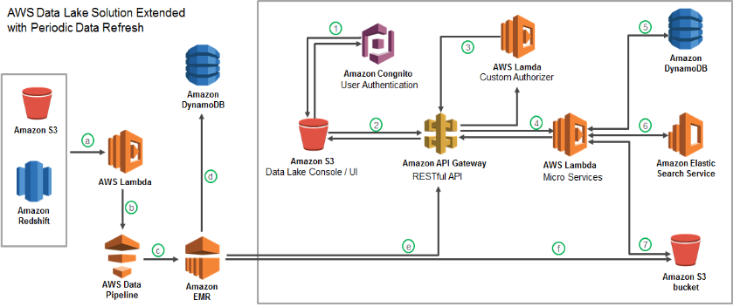



Cloud based data lake to enhance Analytics Operations
Largest Food Distributor in the US
The Problem: Ageing legacy Business Analytics Infrastructure with high cost of ownership slowing down realizable analytics value
The “Before” State
LatentView Solution
The “After” State
Business users faced significant delays in accessing and analyzing data and had difficulty in handling large volumes of data for analytics
Migrated 60TB of data from legacy systems into a cloud based data lake with extended periodic data refresh which supports reporting and advanced analytics solutions
Reduced cost of ownership and increased throughput of cloud hosted analytics solutions
Recommendation Engine
Order Anomaly Detection
Product Substitution
Revenue Management

Slide 37
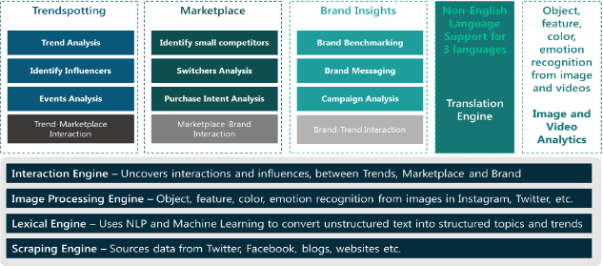
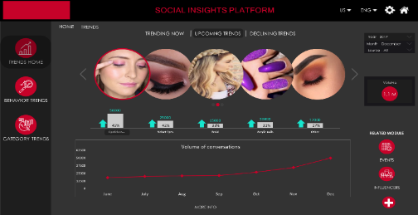
Social Insights Platform for Fashion Trends Spotting
Leading US Cosmetics Company
The Problem: Understanding the make-up and personal care needs of the women in the 18-34 age range is critical in the cosmetics industry
The “Before” State
LatentView Solution
The “After” State
Loyal consumers of the client’s cosmetics line was aging and the impression of the brand had been in steady decline among younger women for the past few years
Building a social insights platform to mine the rich data of the target demographic available in social media to spot trends, rate influencers, identify upcoming competitors, refine campaign messaging and understand drivers of purchase
Ability to score trends that could become mainstream ahead of time helped the company to improve their product launch success rate by 5% in the first 6 months

